Slide 1

TASK SUMMARY REPORT

Slide 2
Pie chart showing the Distribution of Customer Sentiment :
Out of 796 reviews, 515 were positive, 268 were negative and 13 were neutral
-> This means the majority of reviews were polarised as positive

Slide 3
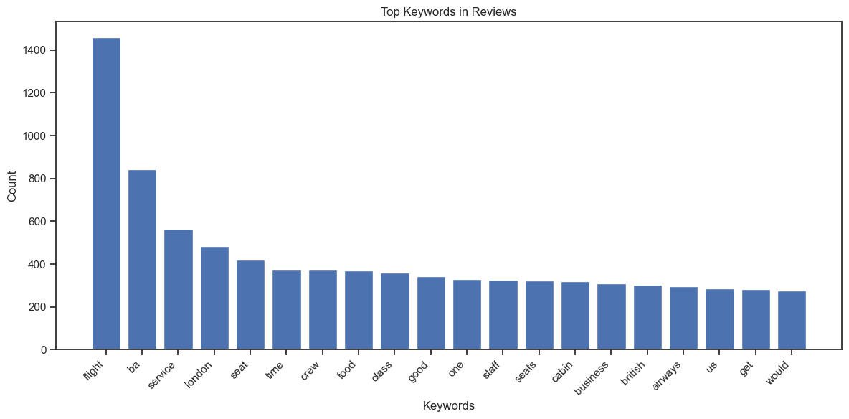
The frequency chart below shows that the key topics within the reviews include “service”, “seat”, “crew” and “staff”, showing that people are actively talking about their experience and staff .

